Slide 1
BRIEF THIẾT KẾ WEBSITE

Slide 2



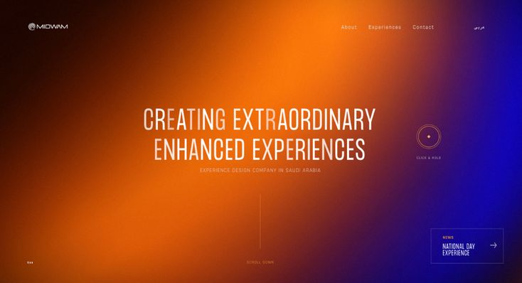
MOOD & TONE

Slide 3
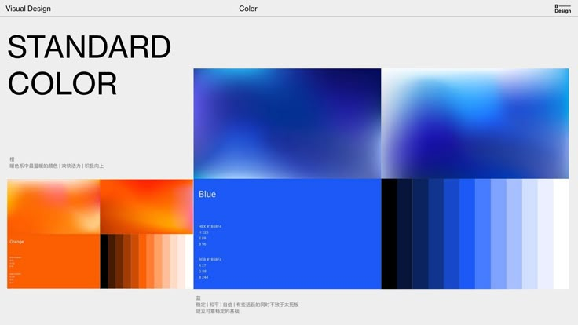

Slide 4
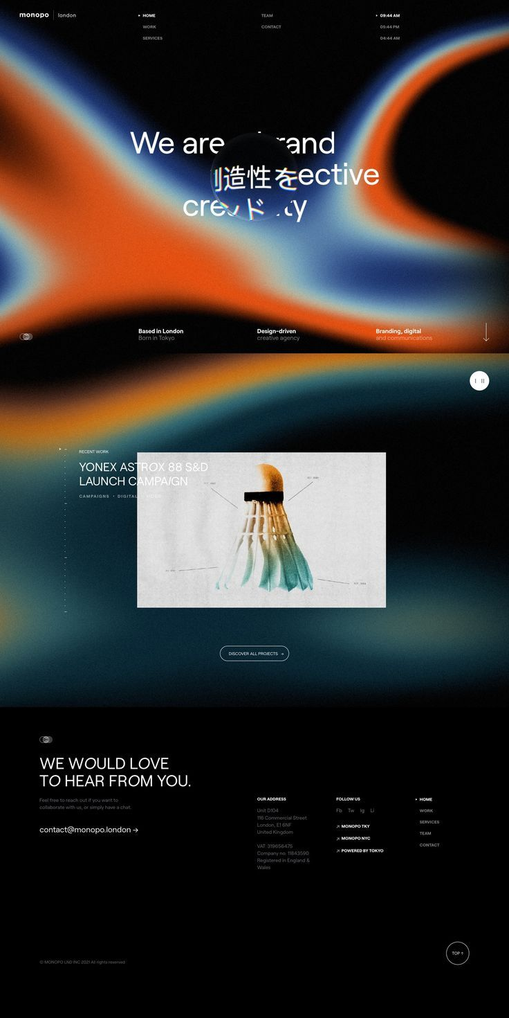
THAM KHẢO
https://www.pinterest.com/pin/1407443629668891/

Slide 5
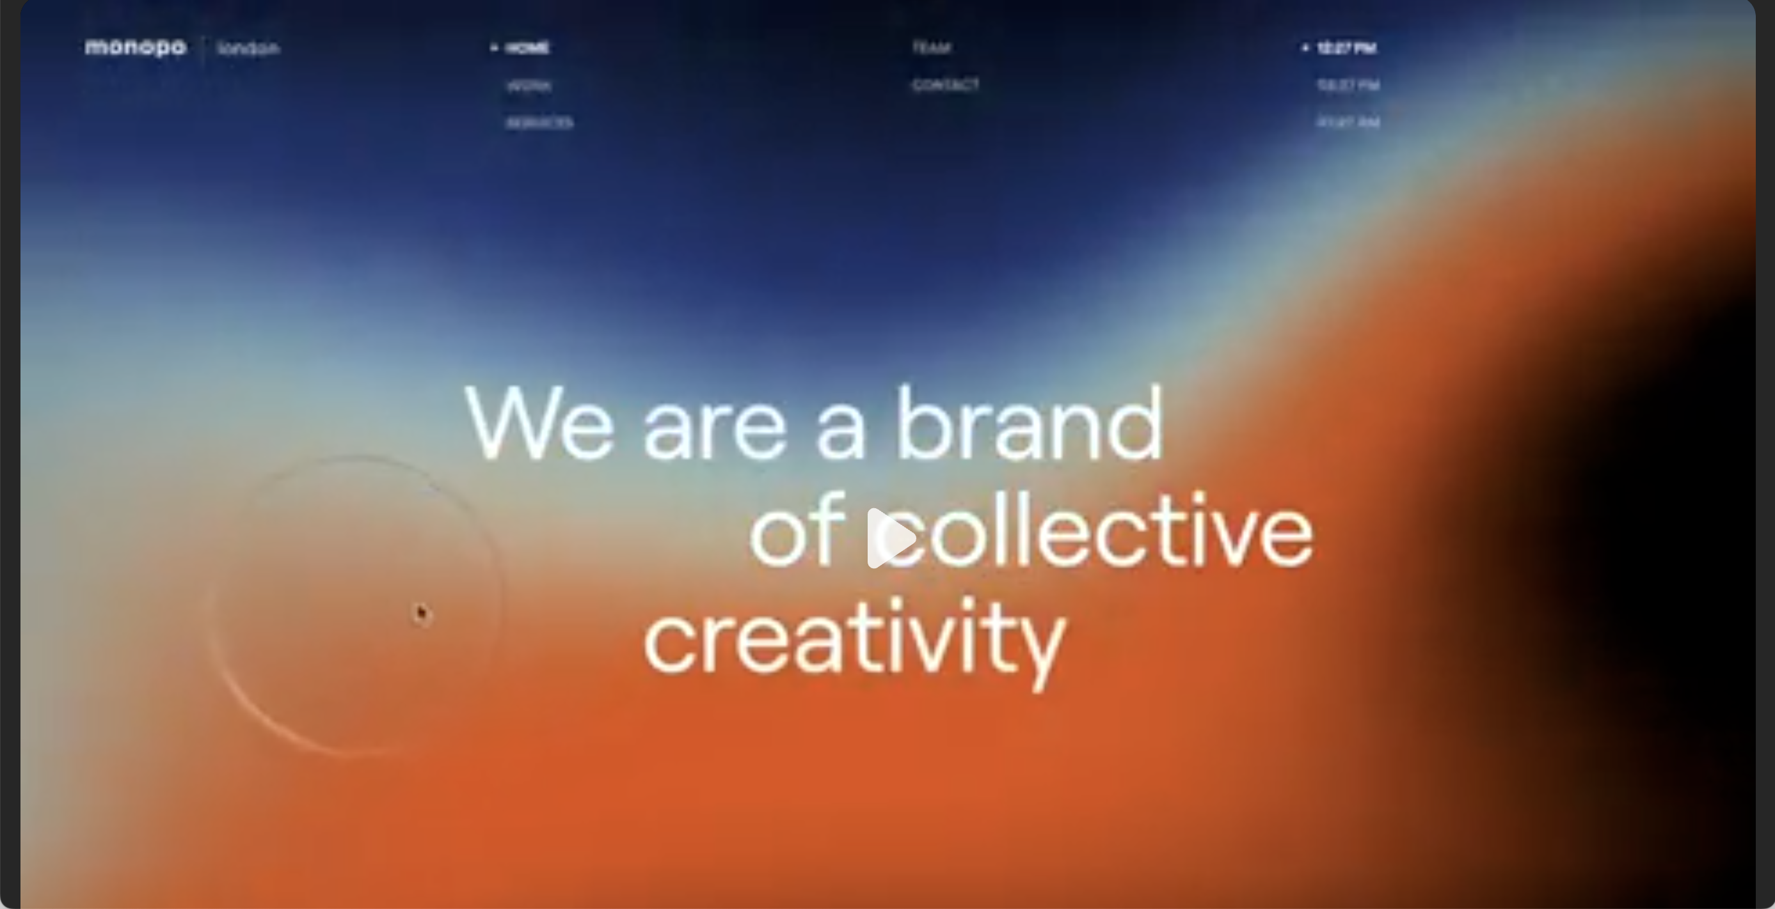
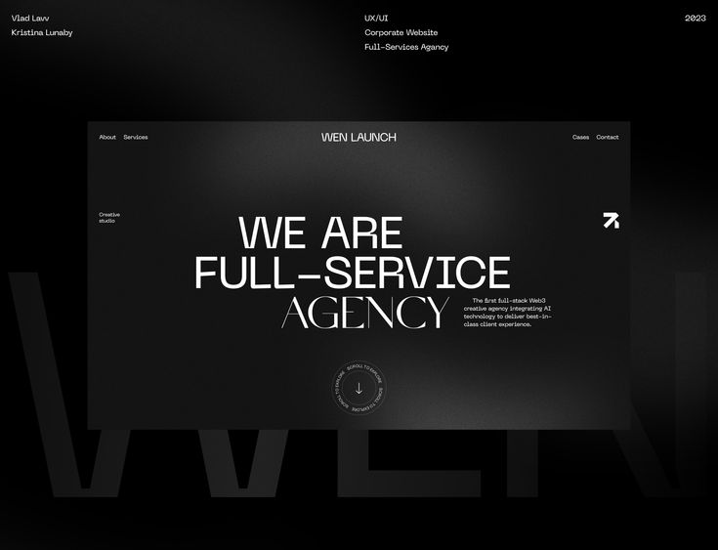
HOMEPAGE
We are an event experience agency
We partner with global and local brands and trusted talents for truly creative content solutions. Branding – Content – Design – Visuals – Marketing – Events

Slide 6
HOMEPAGE
About
Services
Careers
Podcast
We are an event experience agency
We partner with global and local brands and trusted talents for truly creative content solutions. Branding – Content – Design – Visuals – Marketing – Events

Slide 7
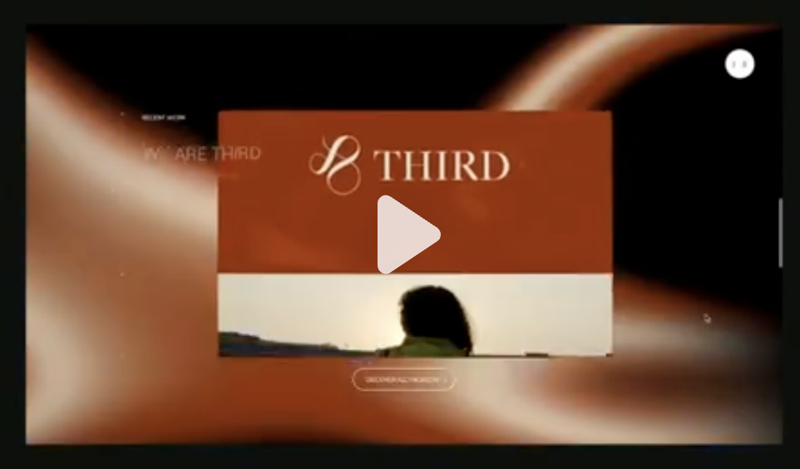
HOMEPAGE
What we do
We don’t just organize events; we ignite emotions, command the spotlight, and leave audiences wide-eyed.
CLIP SHOWREEL
SHOW MORE

Slide 8
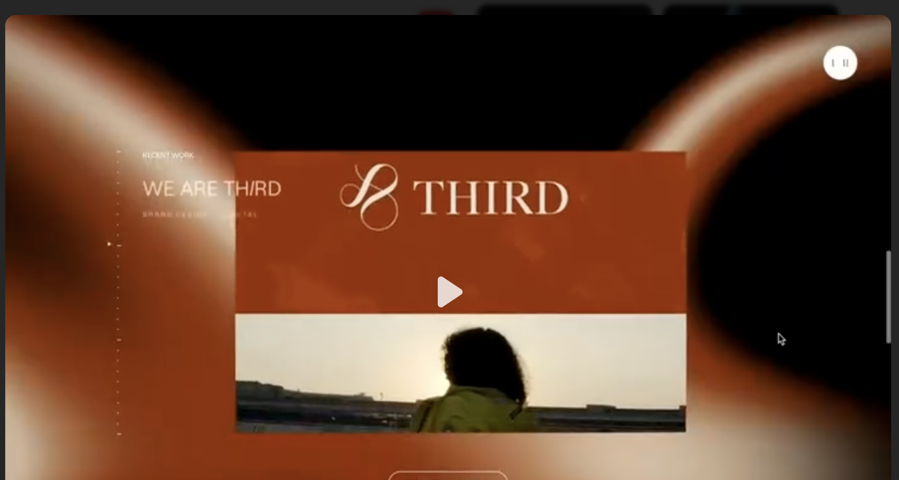
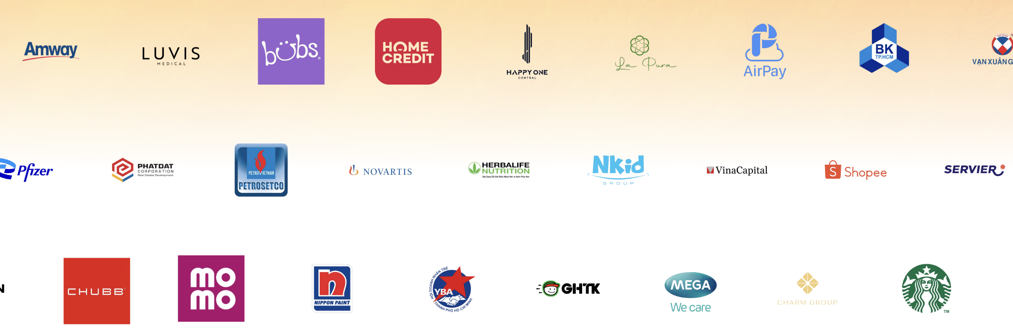
HOMEPAGE
CLIENTS
Being alongside our esteemed clients is the greatest pride of B2EVENT. Every milestone our clients achieve becomes a source of inspiration for us to continuously innovate, create, and push beyond limits.

Slide 9
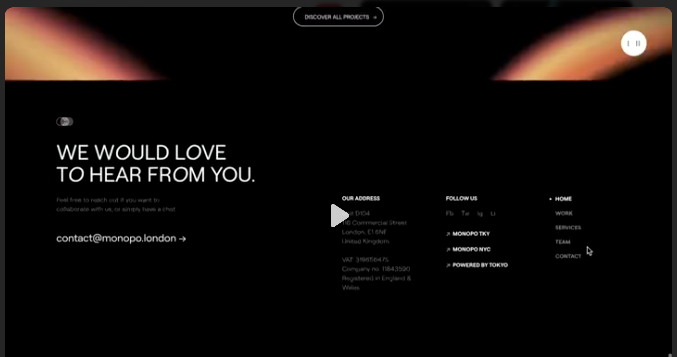
Ho Chi Minh Head Office
75 Hoang Van Thu Street, Cau Kieu Ward, Ho Chi Minh City
(028) 38 225 34781/782/783
CONTACT B2EVENT
Email: contact@b2event.vn
Hotline/Zalo : 0907 561 170 - Kevin Dang
Working Hours: 9:00 AM – 6:00 PM
WE WOULD LOVE TO HEAR FROM YOU

Slide 10
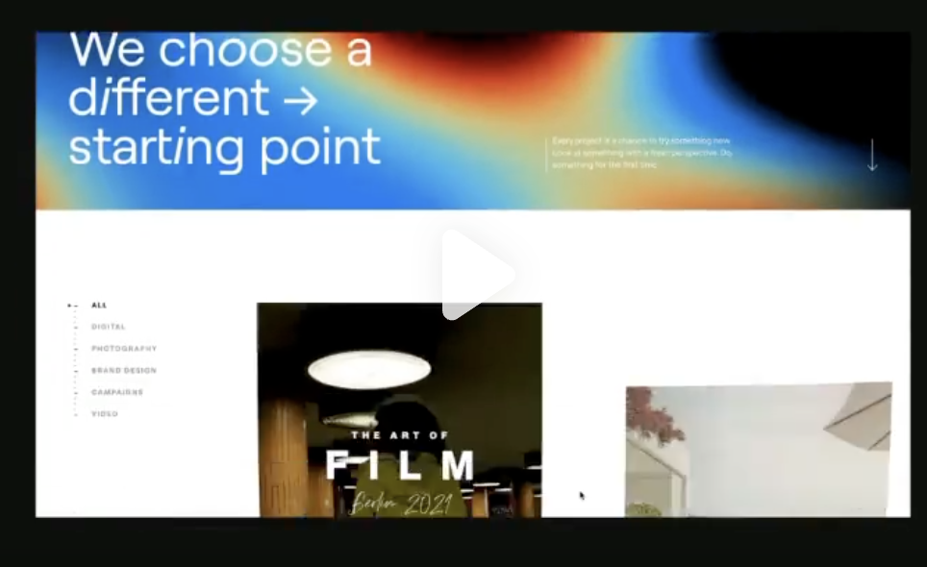
SERVICES
We’ve got the secret sauce — and it lights up every stage. We don’t just organize events; we ignite emotions, command the spotlight, and leave audiences wide-eyed.
All
Event Launches
Conferences & Seminars
MICE
Private Events
Corporate Events
Mega Festivals
Brand Activation
In-house Production

Slide 11
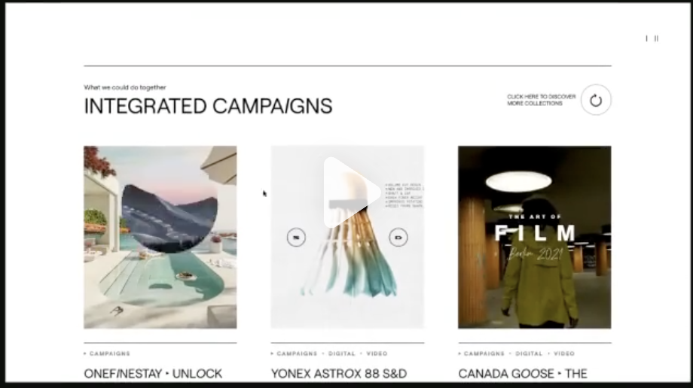
Event Launch Services That Create Impact
A successful launch event sets the tone for your brand’s future. At B2Event, we craft launch experiences that capture attention, strengthen brand positioning, and drive real market momentum. From concept development to production and guest management, every element is designed with precision and powered by storytelling.
Our Event Launch Capabilities
Product Launch Events
Grand Openings
Press & Influencer Launches
App & Platform Launches

Slide 12
Professional Conference & Seminar Management
We design conferences and seminars where ideas connect, leaders engage, and industries evolve. From agenda planning to speaker support and technical production, our team delivers seamless, meaningful experiences from start to finish.
Services Include
Business Conferences
Sector & Industry Seminars
Leadership Forums
Professional Workshops

Slide 13
MICE Solutions for Global Business Growth
We deliver end-to-end MICE solutions through strategic planning, premium hospitality, and world-class execution. Backed by strong global networks and deep expertise, we create seamless corporate journeys and meaningful international engagement.
MICE Services
Incentive Trips
Corporate Meetings
International Conventions & Exhibitions
Business Delegation Management

Slide 14
Private Events with Distinctive Experiences
We curate private events that are intimate, refined, and deeply personalized. Every detail is thoughtfully designed to reflect your identity, elevate emotions, and create memorable moments for select audiences.
Private Event Services
VIP & Invitation-Only Events
Private Dinners & Executive Gatherings
Client Appreciation Events
Milestone & Anniversary Celebrations

Slide 15
Corporate Events that Inspire & Unite
We design corporate events that strengthen culture, align teams, and communicate strategic vision. From internal milestones to large-scale company moments, we turn business objectives into engaging shared experiences.
Corporate Event Services
Annual Meetings & Town Halls
Kick-off & Internal Conferences
Year-End Parties & Celebrations
Company Anniversaries

Slide 16
Brand Activation that Drives Engagement
We create immersive brand activations that connect brands with people through interaction, emotion, and experience. Our activations are designed to spark curiosity, encourage participation, and leave lasting brand impressions.
Brand Activation Services
Experiential Marketing Campaigns
Pop-up Experiences & Interactive Booths
Roadshows & On-ground Activations
Sampling & Consumer Engagement Programs

Slide 17
Mega Festivals & Large-Scale Public Events
We produce large-scale festivals that celebrate culture, entertainment, and community. With strong creative direction and operational excellence, we deliver high-impact events that captivate massive audiences and generate wide media reach.
Mega Festival Services
Music & Entertainment Festivals
Cultural & Community Events
City-wide Celebrations & Countdown Events
Public Brand Festivals

Slide 18
In-house Production & Technical Excellence
With in-house production capabilities, we maintain full control over quality, creativity, and execution. From concept to on-site delivery, every technical element is seamlessly integrated to bring ideas to life.
In-house Production Services
Creative Concept & Show Direction
Stage Design & 3D Visuals
Technical Production & Event Operations
Content, Visual & Multimedia Production

Slide 19
CAREERS
We are constantly seeking promising candidates to nurture and support their professional growth. At B2Event, every talent is given the space, guidance, and mentorship needed to grow, advance, and thrive in their career.

Slide 20
Every episode is crafted with fresh voices, bold perspectives, and stories that truly move people. We don’t recycle ideas. We reimagine them.

